Slide 1
Solution
Design for Governance

Slide 2


Tenant Root Group
Apparel
Tailwinds
Sporting Goods
Product Development
Marketing
Sales
Product Development
Marketing
Sales

Slide 3
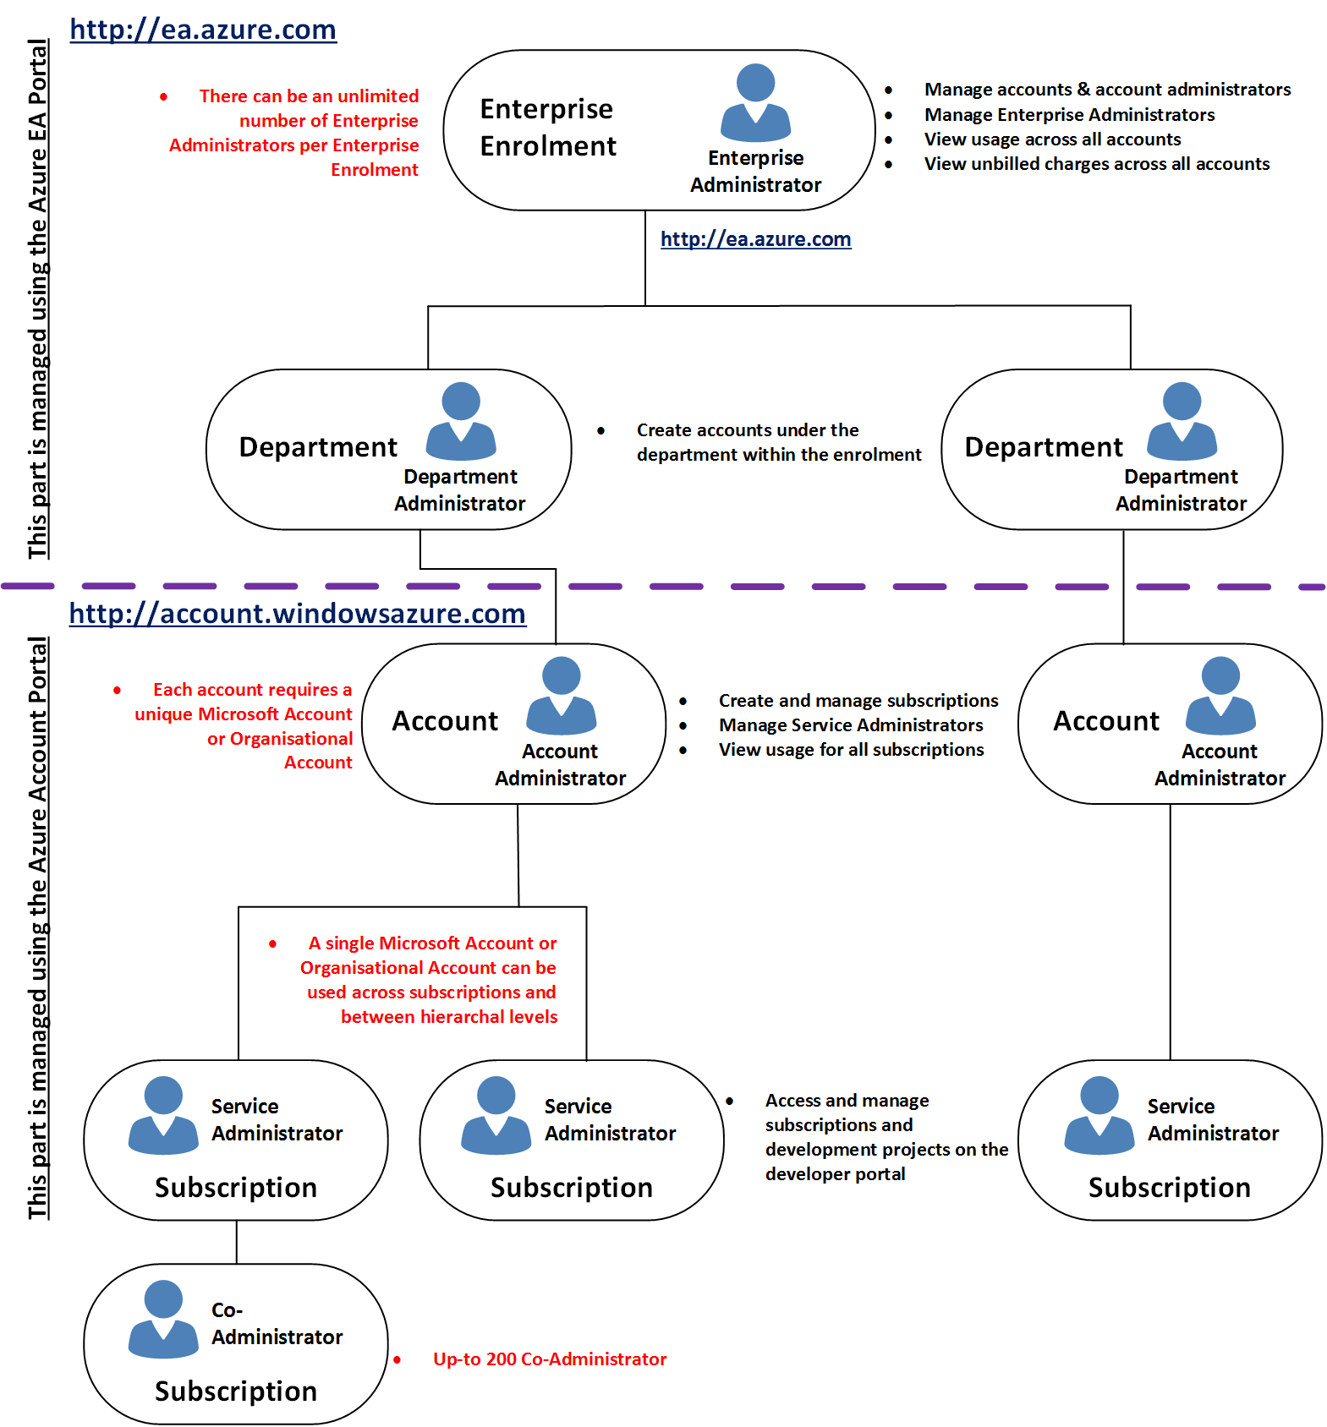

Slide 4
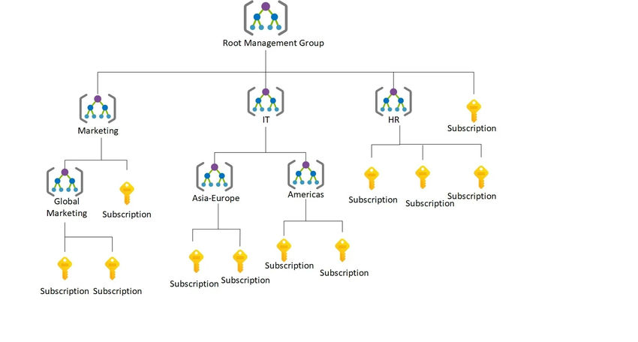















Slide 5











